Slide 1
Local vs Global Scope

Slide 2
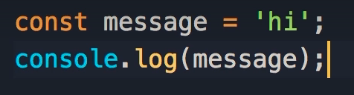
Scope
In this discussion, we will be covering a very important concept called scope.
Here we define a constant called message and set it to ‘hi’.
When we log message, we get ‘hi’ in our console
Notes:
In this lecture we're going to talk about a very important concept called scope.
So I'm going to define a constant called message and set it to hi.
Now let's log this in the console so obviously we get hi on the console.

Slide 3
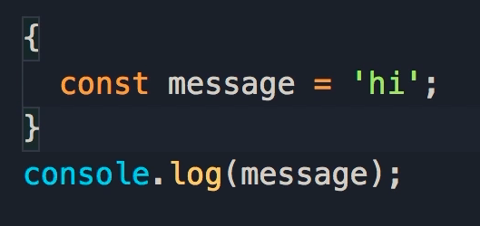
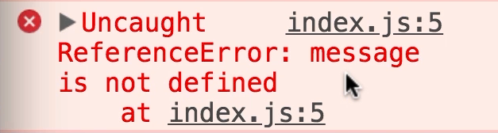
Moving Variables
What would happen if we place our constant in a code block?
We get this error:
Uncaught ReferenceError: message is not defined
This is all about scoping
Notes:
But what would happen if I add this message in a code block?
Let's save the changes and see what happens.
We get this error. Uncaught reference error, message is not defined.
This is all about scoping.

Slide 4
Scope
When we declare variables or constants with let or const, their scope is limited to the block in which they are defined.
Scope of a variable or a constant, determines where that variable or constant is accessible.
Notes:
So a scope of a variable or a constant, determines where that variable or constant is accessible.
And when we declare variables or constants with let or const, their scope is limited to the block in which they are defined.

Slide 5
Scope
That means message is accessible within the code block, but not outside it.
So why would our message constant be in a code block?
Notes:
So message is accessible in this block, but it's not accessible outside of this block.
Now you might be wondering why do we need this code block here?

Slide 6
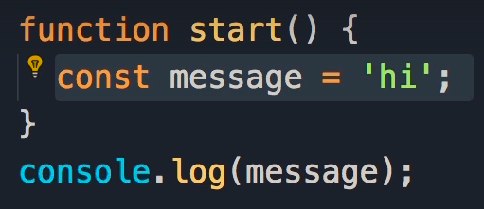
Scope of Functions
The code block could be part of a function.
Here we have a function called start.
Because the scope of this constant is limited to the block in which it's defined, we cannot access this constant outside of the start function.
Notes:
Well, this code block can be part of a function.
So here we can have a function called start.
And now we have a constant in this function.
So because the scope of this constant is limited to the block in which it's defined, we cannot access this constant outside of the start function.

Slide 7
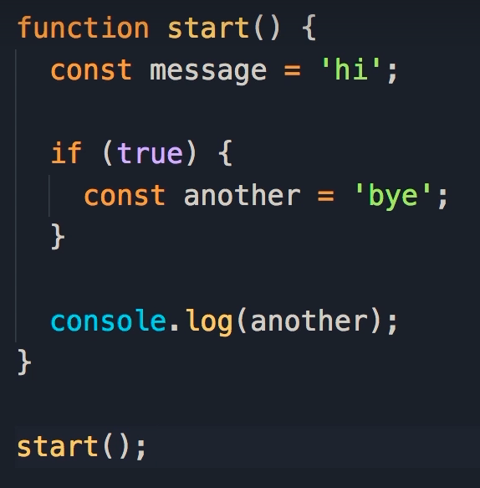
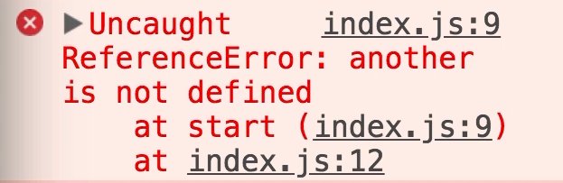
If statements
The same is true when we declare a variable or constant in an if block.
Here we set up an if statement, within which we have declared a constant called another.
This constant is only accessible in this block, if I go out of this block, and try to log it on the console, we're going to get an error.
Notes:
The same is true when we declare a variable or a constant in an if block.
So, let's add an if block here, some condition, we don't care, let's declare another constant, and set it to bye.
Now, this constant is only accessible in this block, if I go out of this block, and try to log it on the console, we're going to get an error.
So, I'm going to remove the last line, let's just call the start function.
Save the changes, we get the same error.
Reference error. Another is not defined.

Slide 8
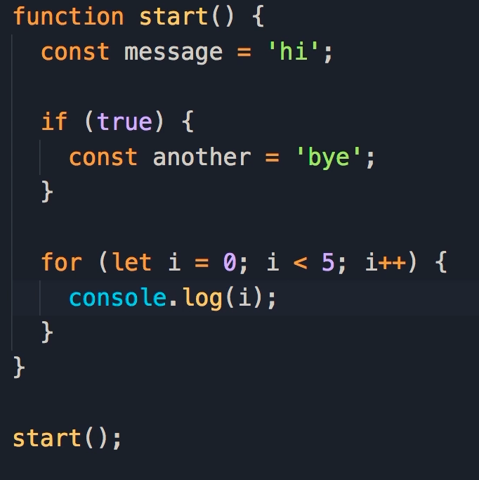
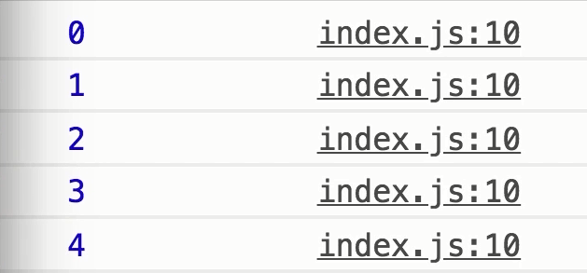
Loops
We have the same concept with loops.
Here we define a loop to run 5 times.
Note that i is now a variable only available in this block.
When we log i, we get the numbers 0-4 in our console.
Notes:
We have the same concept in our loops.
So let's define a for loop, let i = 0, we're gonna run it 5 times, now i is a variable that is only accessible in this block.
So here, we can log i, let's save the changes, we get numbers 0-4.

Slide 9
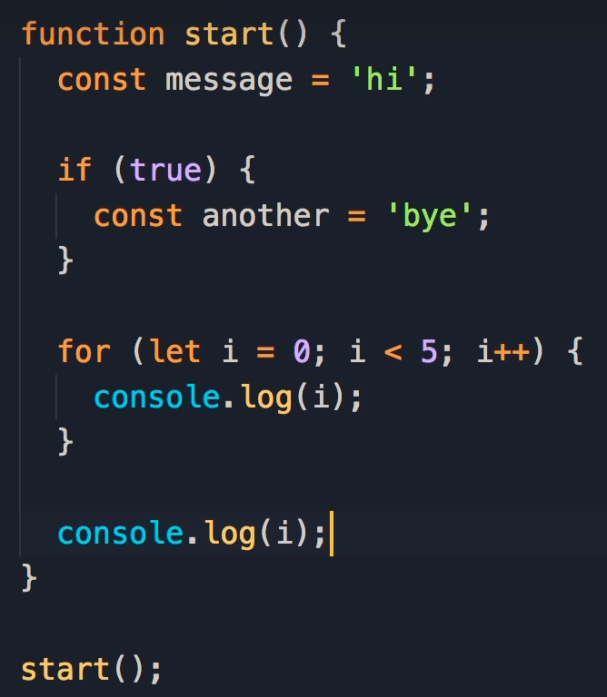
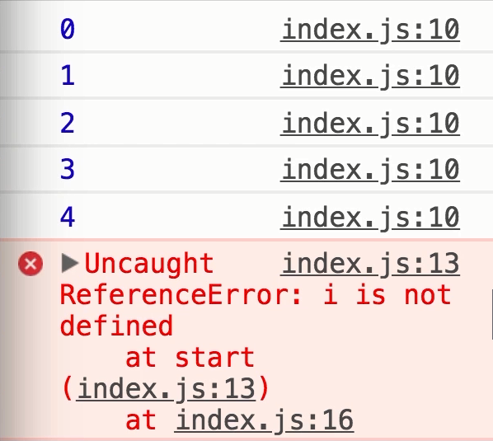
Scope
If we log i outside of the loop, we will get a reference error.
Notes:
But if we go outside of this for block, and log i, we're going to get the same error.
Reference error, i is not different.

Slide 10
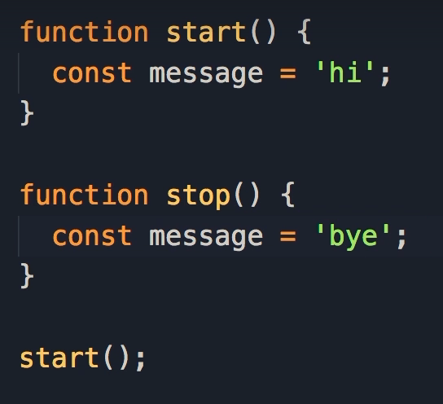
Scope
Here we have 2 functions: start() and stop().
Each of them have a constant called message, with a different value assigned.
This is perfectly valid JavaScript code.
Because the scope of the constant is limited to the block in which it's defined.
So we can have two variables or constants with the same name but different functions.
That's perfectly valid.
Notes:
Now, let me simplify this code.
So we're going to have a function with a constant called message.
We can have another function, let's call that stop.
And in this function we can have a constant called message, with a different value.
That's perfectly valid JavaScript code.
Because the scope of this constant is limited, to the block in which it's defined.
So we can have two variables or constants with the same name but different functions.
That's perfectly valid.

Slide 11
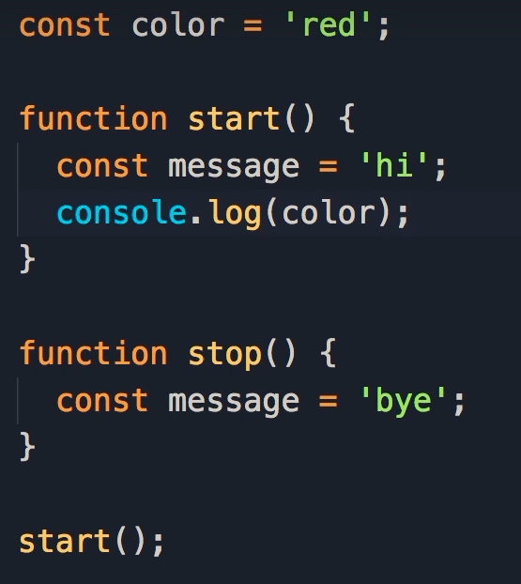

Global Scope
What if we define a variable or constant outside of a function?
Here we have a constant called color and set it to red.
Since this variable is not surrounded by any code blocks, it has global scope.
Global means this constant is accessible everywhere, globally.
In our start() function, we log the color constant.
In our console we see we have access to the color constant, so this constant is accessible to all functions we have in our programm
Notes:
Now, what if we defined a variable or a constant outside of a function.
So here I'm going to define a constant, color, and set it to red.
Now here we don't have any code blocks, so what do you think is the scope of this constant?
This constant has global scope.
Global means this constant is accessible everywhere, globally.
So we can go to the start function and log color, save the changes you can see we have access to this constant, color, so this constant is accessible in all the functions we have in our programming.

Slide 12
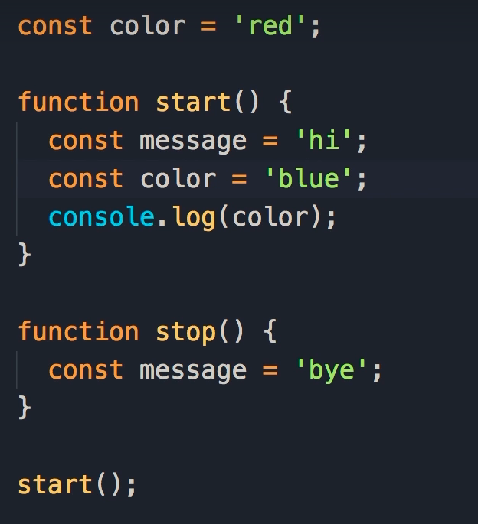

Scope
Here we declared another constant with the same name within our function, and assigned it the value of ‘blue’
When we log color within the function, blue is displayed on the console.
Therefore, local variables and constants take precedence over global variables and constants.
In general, you should avoid defining global variables or constants.
This is considered bad practice.
Notes:
Now what if we have a constant with the exact same name, in our function.
So let's take a look, I'm going to define this color constant, we'll set it to blue.
What do you think we're going to see when I save the changes, let's take a look.
We get blue.
So, local variables, or local constants in a function, take precedence over global variables or constants.
Now in general you should avoid defining global variables or constants, that is considered bad practice.

Slide 13
Metaphor
You don't want to share a toothbrush with multiple people.
Each person should have their own toothbrush.
You should avoid defining global variables or constants because they're accessible globally, and each function can accidentally change their value, and this will lead to all kinds of bugs and issues in our programs.
Imagine that a constant/variable is a toothbrush and each function is a person.
Notes:
Let me give you a metaphor.
Imagine this is a tooth brush, and each function is a person.
You don't want to have a tooth brush that is shared with multiple people.
Each person should have their own tooth brush.
So you should avoid defining global variables or constants because they're accessible everywhere, globally, and each function can accidentally change their value, and this will lead to all kinds of bugs and issues in our programs.

